Slide 1
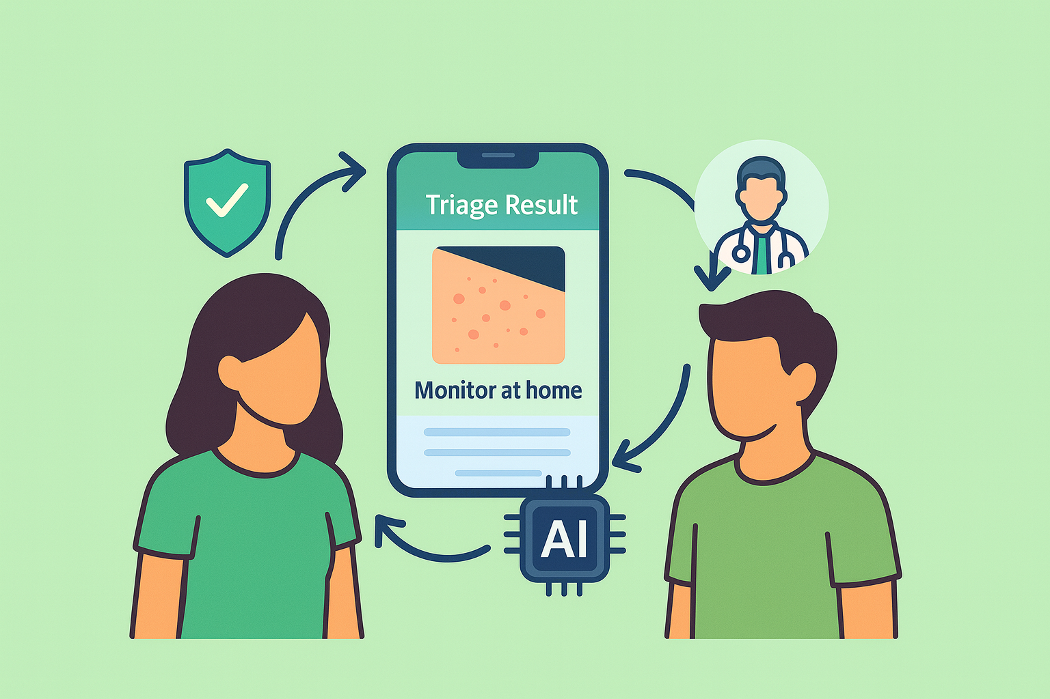
Edgecare - Triage
Contributors:
Himaja Kaishetty
Vamshi Krishna Balupari
Tharun Guda
Viswas Setty

Slide 2
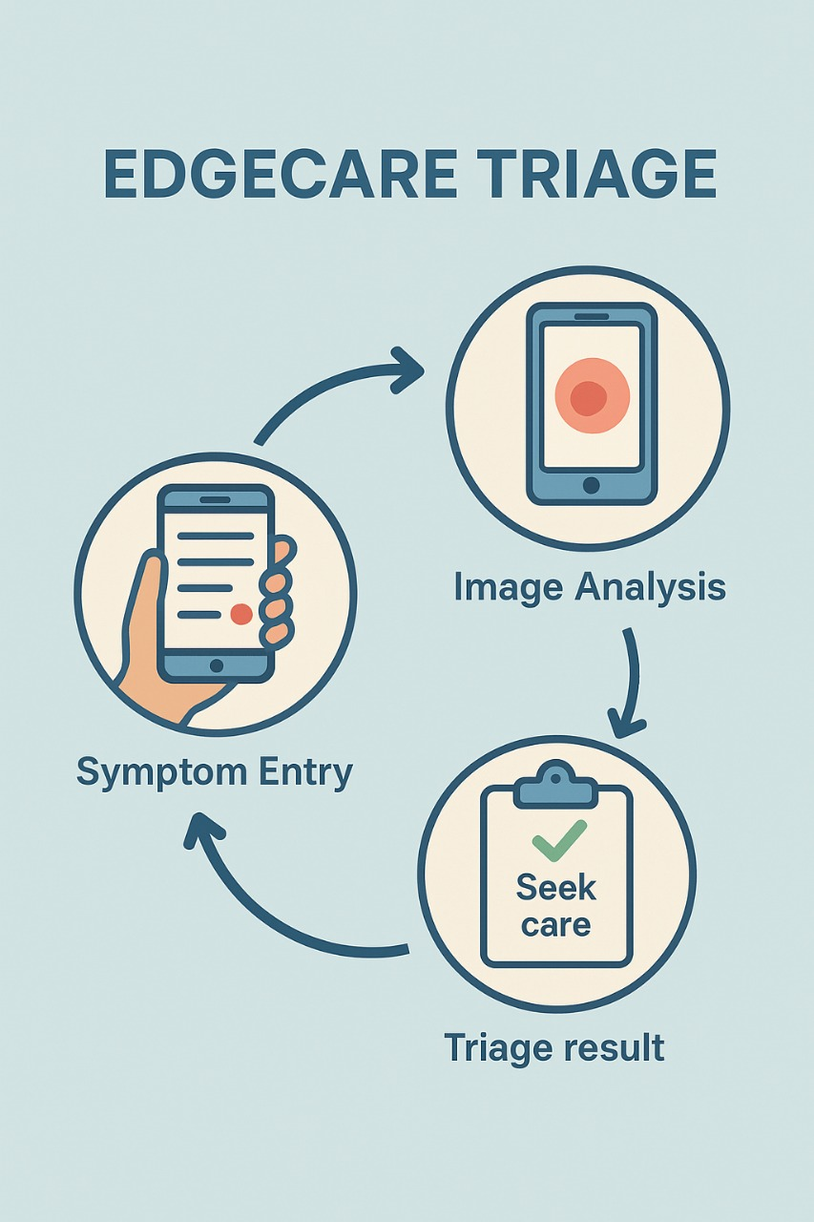
Outline
Introduction
Problem Statement
Use Cases
Functional Requirements
Non-Functional Requirements
Architecture Diagram / Plan
Design Patterns to Be Used
Platforms and Technologies
Third-Party Libraries to Provide Functionality
Hosting Strategy and Requirements
Data Management Plan
Prototype Demos
GUI Mockups
Functional Prototypes
What Has Been Accomplished
Spring 2026 Plan
Reference-APA

Slide 3
Introduction
EdgeCare – Triage is a brand-new web and mobile app designed to accelerate and simplify the pre-diagnosis process for both care providers and patients. The app utilizes device-based AI to deliver quick, precise tests with all individual health data kept confidential.
The patients engage with the app through answering straightforward health-related queries or sharing an image such as skin issues in return for instant guidance on whether a doctor's consultation is necessary or not. Such preliminary reports are then securely routed to doctors, who can verify or extend the findings through a specialized portal.
Through combining real-time AI triage with safe doctor-to-doctor consultation, EdgeCare makes healthcare delivery faster, safer, and more accessible to everyone.

Slide 4
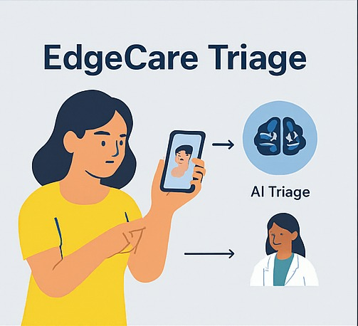
Problem Statement
Patients can't rapidly estimate symptom severity and suspect online assessments on grounds of privacy, leading to delayed treatment, while clinics waste capacity on non-emergency cases that pre-screening would have screened out.
Physicians/Doctors have significant inefficiencies in patient flow. They spend most of their time with patients who are marginal or non-emergency and ought to have been pre-screened, robbing time from more critical patients.
The existing procedure of ascertaining whether a patient should be treated medically has certain inefficiencies and flaws. Patients are reluctant to visit a physician because they are unsure about the severity of their symptoms. This leads to more serious ailments receiving hospitalization or even postponed treatment of serious conditions.

Slide 5
UseCases
Validate Required Fields – Ensures completeness before submission.
Submit Symptoms/Photos – Secure input + instant confirmation.
Optimize Image – Auto resize/compress for faster AI triage.
Clear Error Messages – Simple feedback; no data loss.
View Triage Results – Latest severity score + steps.
Emergency Contacts – Quick access during high‑risk alerts.
Session Timeout – Auto logout for privacy.
Maintain Audit Log – Full trace with timestamps & roles.
Role‑Based Access – Strict patient/doctor data separation.
Adaptive Questionnaire – Real‑time dynamic follow‑ups.
Health Dashboard – Key AI insights & summaries.
Selective Data Export – Filtered, secure data export.
Regional Customization – Region‑specific medical questions.

Slide 6
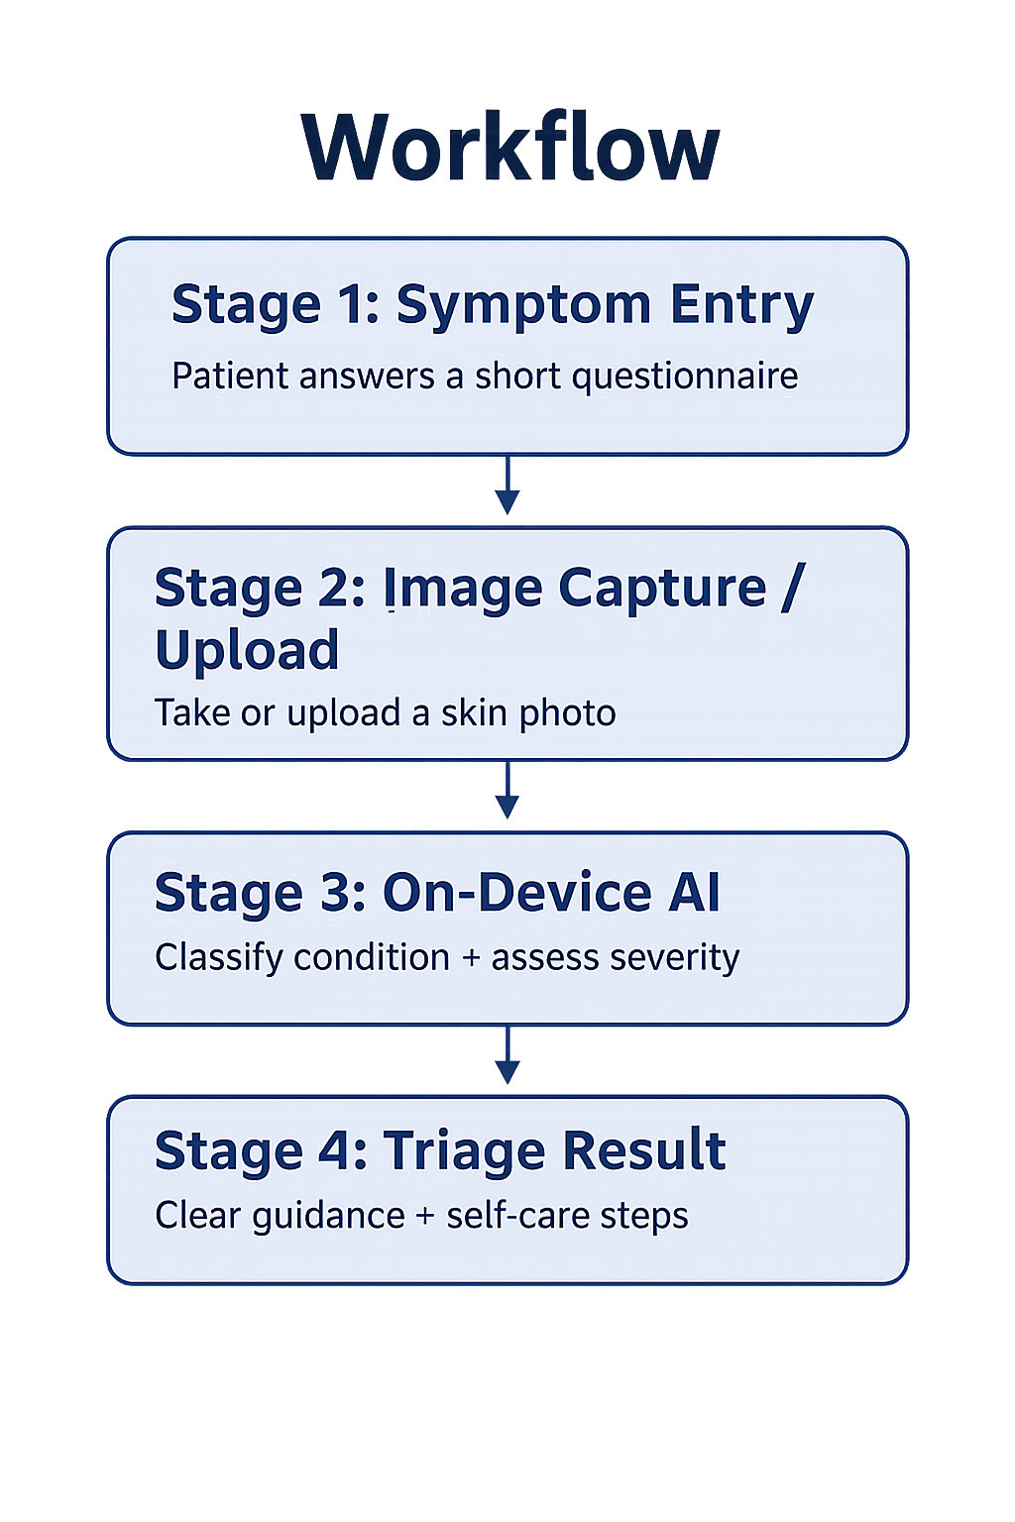
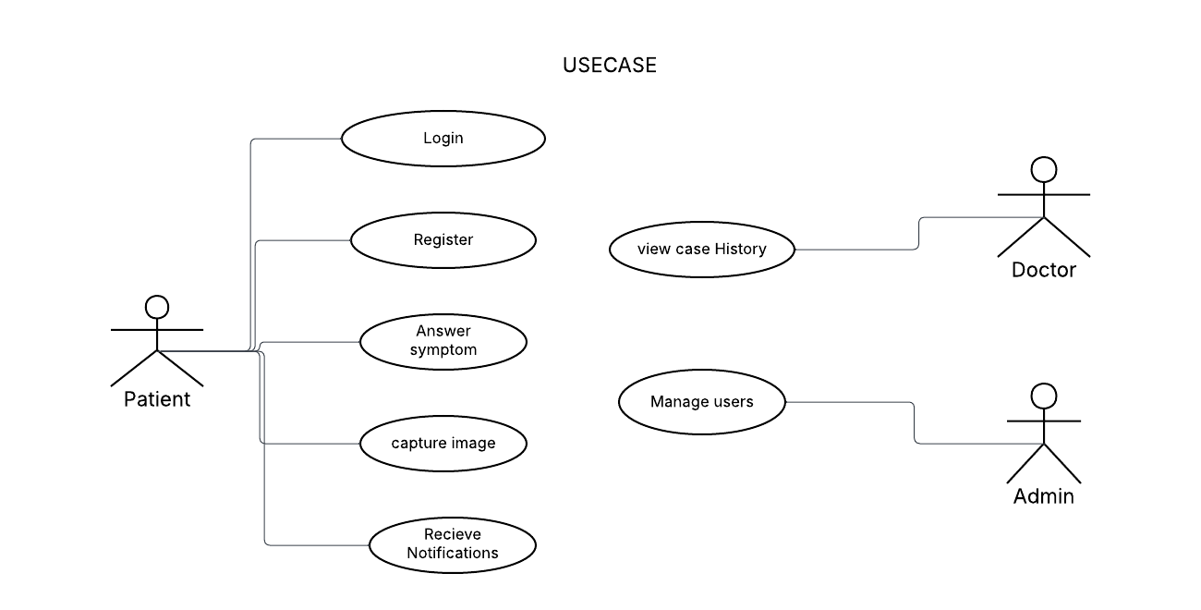

Slide 7
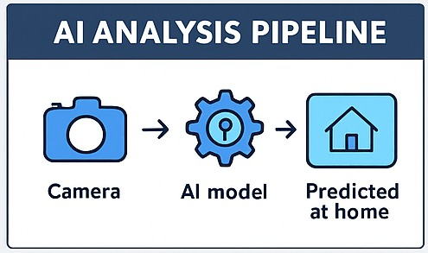
Functional Requirements
Should -
Adaptive questionnaires based on patient responses
Personalized health dashboards with key metrics
Selective data export (e.g., AI vs doctor reports)
Regional customization of medical questions
Shall -
Patients can update demographic info (e.g., age, allergies, conditions)
Instant confirmation after submitting symptoms or images
View latest triage results before session ends
Emergency contact access when risky symptoms are detected
Auto logoff after inactivity to protect privacy

Slide 8
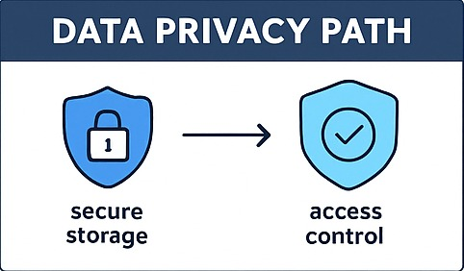
Non - Functional Requirements
Performance - process uploaded images and symptom data, load interfaces and render results
Security - Advanced Encryption Standard-256 encryption and securely transmitted using Transport Layer Security 1.3.
Stability & Reliability - support zero loss of data for continuous or completed triage cases.
Availability - view initial diagnoses and view precautionary measures.
Usability - Results, reminders, and advice must be presented in clear, actionable language.
Scalability - support multiple users with less degradation.

Slide 9
Architecture Diagram / Plan
Client Layer (Frontends)
Mobile app for patients (Android / iOS).
Web portal for doctors and admin users.
AI Triage Layer (On-Device + Service)
On-device AI model (rash image classification + severity scoring).
Pre-processing (resize, normalize, compress image).
Application / API Layer
RESTful APIs for case management, triage results, user profiles.
Authentication & authorization (patients vs doctors).
Data & Persistence Layer
Relational database for users, cases, triage history, audit logs.
Encrypted storage for sensitive fields and image metadata.
Cross-Cutting Services
Audit logging service (append-only logs).
Monitoring, metrics, and error logging.

Slide 10
Design Patterns to Be Used
MVC (Model–View–Controller)
Separates UI (screens/pages), business logic (triage rules, validation), and data (models, repositories).
Applied in both mobile app and web portal.
Repository Pattern
Clean abstraction for data access (cases, users, triage results, logs).
Makes it easier to switch DB or mock data in testing.
Singleton Pattern
Single in-memory instance of the AI model (TFLite) per device / per server process.
Avoids repeated model loading and improves performance.
Observer / Publisher–Subscriber
Notifies UI when new triage result is available or case status changes.
Can be used for real-time updates in doctor portal.
Factory Pattern
Generates dynamic triage questionnaires based on rules

Slide 11
Platforms and Technologies
Frontend (Patients & Doctors)
Web: React or Angular for doctor portal.
Backend / API
Node.js (Express) or Spring Boot (Java) for REST APIs.
JSON-based APIs for interoperability.
AI / ML
TensorFlow / TensorFlow Lite for on-device rash image classification.
Database & Storage
MySQL for structured data (users, cases, results).
Encrypted object storage if any images are stored server-side.
Security & Auth
JWT-based authentication.
Role-based access control (patient vs doctor).

Slide 12
Third-Party Libraries to Provide Functionality
Web Utilities
Camera / Image Picker libraries (capture or choose rash images).
HTTP client (Retrofit / Axios / Fetch) for API calls.
AI & Image Processing
TensorFlow Lite runtime (on-device inference).
Optional: OpenCV / image manipulation libraries for resizing/compression.
Security
Crypto libraries for AES-256 encryption of sensitive data.
Libraries for secure password hashing on backend.
UI / Visualization
Chart libraries for doctor dashboards (severity trend, case volume).
Logging & Monitoring
Logging frameworks (e.g Logback).
Integration with monitoring tools.

Slide 13
Hosting Strategy and Requirements
Cloud Hosting
Host backend on AWS .
Managed relational database (My SQL).
Scalability & Availability
Auto-scaling group or serverless platform for handling peak loads.
Load balancer in front of API servers (HTTPS only).
Security & Compliance
All traffic over HTTPS .
Encrypted storage (at rest + in transit).
Strict RBAC and audit logs for access to case data.
Operational Requirements
Regular backups of DB and logs.
Centralized logging, alerts for failures or latency spikes.
Staging environment for testing before production deployment.

Slide 14
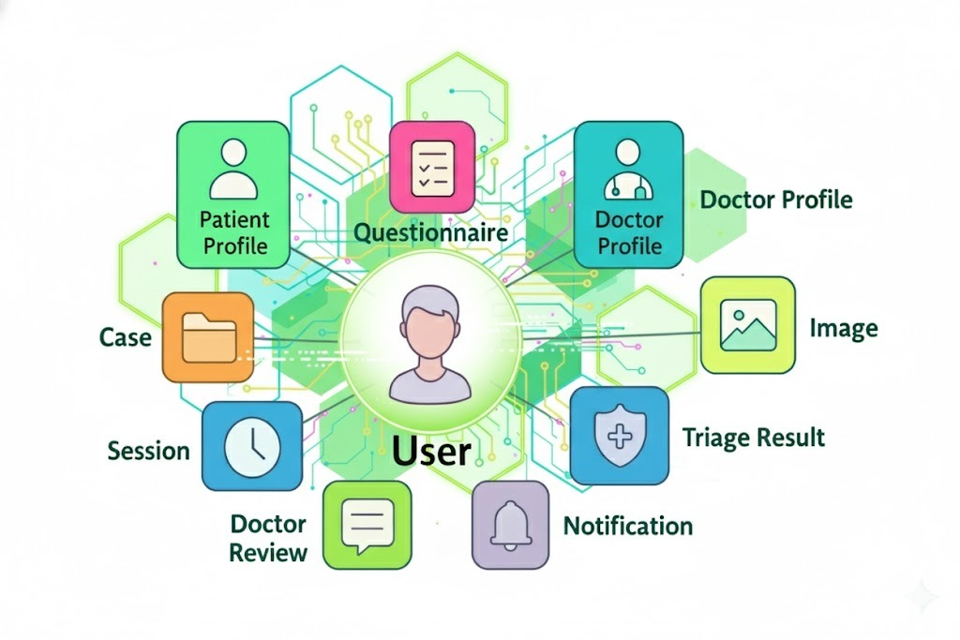
Data Management Plan

Slide 15
Prototype Demos (What we will show live)
Prototype Demo 1 – Patient Triage Flow
Patient logs in and opens the “New Case” screen.
Fills a short symptom questionnaire and uploads a skin rash photo.
App validates required fields and shows inline error messages if anything is missing.
On submission, a mock AI result (e.g., “Moderate severity”) is displayed with suggested next steps.
Prototype Demo 2 – Doctor Case Review (Portal)
Doctor logs into the web portal.
Views a list of recent patient cases with basic filters (date, severity).
Opens a case to see: symptoms, image preview, AI result, and notes section.
Demonstrates override action (doctor can change severity or add comments).
Prototype Demo 3 – Reliability & UX Behavior
Show session timeout behavior after inactivity (auto logout).
Show clear error message when upload fails (network off example).
Confirm that patient inputs remain on screen even after an error.

Slide 16
GUI Mockups (Screens/UI we designed)
Patient App – Key Screens
Home / Dashboard
Entry point showing “Start New Triage” and “View Past Results.”
Symptom Input Form
Simple, scrollable form with radio buttons, sliders (e.g., pain level), and text fields.
Required fields marked clearly with asterisk.
Image Capture / Upload Screen
Buttons for “Take Photo” and “Choose from Gallery.”
Image preview area with option to retake.
Triage Result Screen
Card showing severity level, color code (e.g., green/yellow/red), and recommended action (self-care vs see doctor).
Doctor Portal – Key Screens
Case List View
Table of cases with patient ID, date, severity, status.
Case Details View
Symptom summary, rash image preview, AI result, doctor notes, and override controls.

Slide 17
Functional Prototypes
Patient Onboarding & Login
Basic registration/login with patient role.
Symptom Capture
Working symptom form with required-field validation.
Error messages and focus on missing fields.
Image Upload & Optimization
Capture/choose image from device.
Resize/compress large images before sending to backend/AI stub.
Triage Result Display (Mock AI)
Placeholder AI service returns sample severity levels.
Frontend displays severity + text recommendations.
Audit Log Stub
On each case submission, a log entry is written (patient, action type, timestamp).
Role-Based Views
Patient can only see their own cases.
Doctor portal shows assigned cases only (basic filter).
In Progress / Next Steps
Expand doctor portal actions (override, follow-up scheduling).
Enhance dashboard visuals (charts, trend lines).

Slide 18
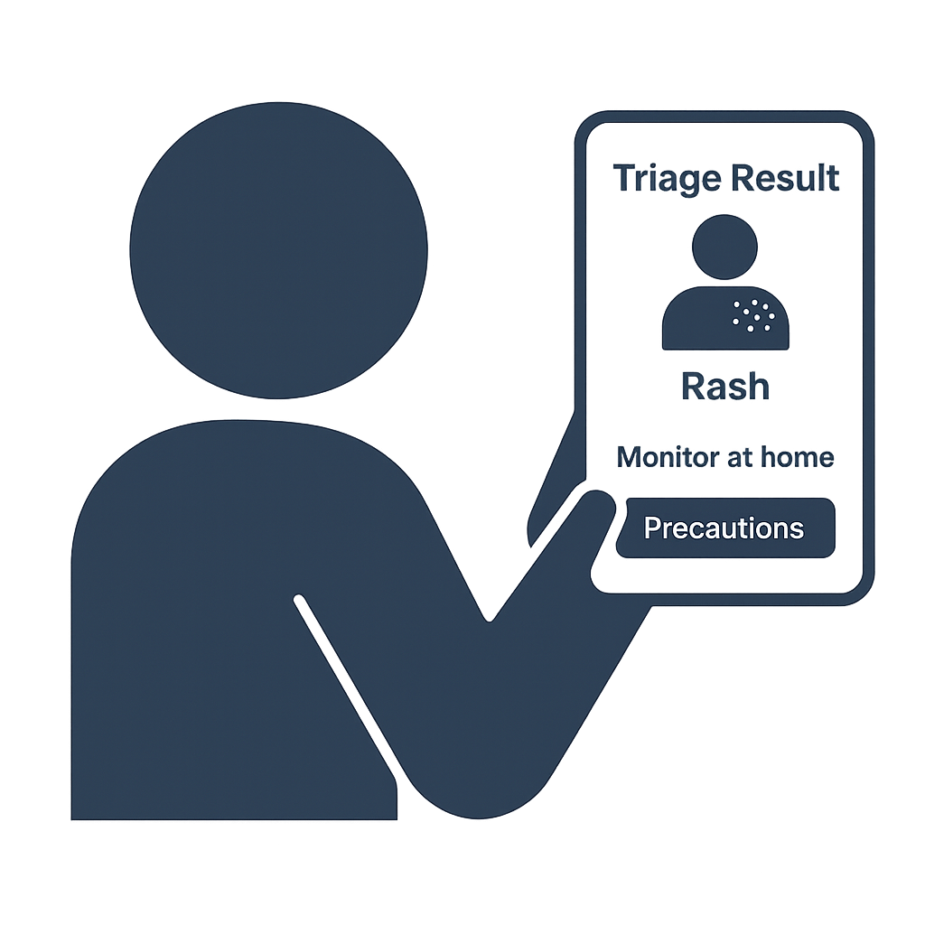
What Has Been Accomplished :
Completed all 13 detailed use cases for patient & doctor flows.
Completed dataset analysis, preprocessing pipeline, and model planning.
Finalized architecture, tech stack, and design patterns.
Designed full GUI mockups + interactive prototypes.
Built functional prototype (symptom form, image upload, compression, mock AI, RBAC, audit logs).
Completed full SRS, DMP, and updated GitHub Wiki documentation.

Slide 19
Spring 2026 Plan:
Train + integrate TFLite AI model.
Build complete backend (APIs, RBAC, audit logs).
Implement full web application (triage flow, history, export).
Build doctor portal (dashboard, case review, override).
Set up secure DB + encryption + backups.
Connect all components for end-to-end workflow.
Perform testing & QA (AI, UI, performance).

Slide 20
Reference – APA
(DermNet NZ. (2024). DermNet Skin Disease Image Dataset [Dataset]. Kaggle. https://www.kaggle.com/
Howard, A. G., Zhu, M., Chen, B., & Wang, W. (2017). MobileNets: Efficient convolutional neural networks for mobile vision applications. arXiv. https://arxiv.org/abs/1704.04861
Cowie, J., Morgan, M., White, P., & Tully, M. (2020). Digital triage in healthcare: The role of computer-assisted decision-making tools. Journal of Medical Internet Research, 22(10), e17571.
U.S. Department of Health & Human Services. (2023). HIPAA Security Rule. https://www.hhs.gov/
European Commission. (2024). General Data Protection Regulation (GDPR). https://gdpr.eu/
Raschka, S., Liu, Y., & Mirjalili, V. (2022). Machine learning with TensorFlow Lite on mobile and edge devices. O’Reilly Media.

